Slide 1

Employee Management System
Presented By:
Anil kumar Chinthakuntla
Batch No: 436
Location:Dilshuknagar

Slide 2
About me
Background?
I have completed my B.Tech graduation in Electrical Engineer from Annamacharya institute of technology and science
Any work experience
I have 6 years of work experience in Navigation field
LinkedIn profile URL
www.linkedin.com/in/anil-kumar-613978256
Git hub profile URL
https://github.com/anilkumarchinthakuntla

Slide 3
Agenda
Business Problem
Objective of the Project
Data description
ER Diagram and schema explanation
Key analysis questions (use cases)
SQL query results with screenshots or summaries
Final business insights and recommendations
Challenges Working on SQL Project
Conclusion (Key finding overall)
Q&A Slide

Slide 4
Business Problem
In many organizations, employee data and HR processes are managed manually or through disconnected systems, which leads to data inconsistencies, increased administrative workload, and lack of real-time visibility into important HR functions. Current approaches fail to provide a centralized platform for managing comprehensive employee information, including personal records, job roles, salary structures, qualifications, leave history, and payroll calculations. This fragmentation results in redundant data entry, delayed updates, and limited ability to generate accurate reports for decision making and reduces manual effort, ensures data consistency, and enhances operational efficiency across all HR functions.

Slide 5
Objective of the Project
The objective of the Employee Management System project is to design a structured SQL-based system that efficiently manages employee data, job roles, salary details, qualifications, leave records, and payroll processing. The project aims to build a relational database that ensures data accuracy, supports analytical queries, and helps organizations generate useful insights for HR and management decision-making.

Slide 6
Data Description
Table name | Description
JobDepartment | Stores job roles, departments, and related salary ranges
Salary Bonus | Contains salary, bonus, and annual pay linked to specific job roles.
Employee | Maintains personal, contact, and login details of all employees.
Qualification | Records qualifications and required skills for employee job positions.
Leaves | Tracks employee leave records with reasons and dates.
Payroll | Combines employee, job, salary, and leave data to calculate net payments.
● Cascading Delete/Update: For most relationships, the ON DELETE CASCADE and ON UPDATE CASCADE actions are used, meaning that if a record in the parent table (e.g., Employee, JobDepartment) is deleted or updated, the corresponding records in the child tables (e.g., SalaryBonus, Payroll) are automatically deleted or updated as well.
● Set Null on Delete: For the relationship between the Payroll and Leaves tables, ON DELETE SET NULL is used. If a leave record is deleted, the related payroll record will not be deleted, but the reference to the leave record will be set to null.
Foreign Key Constraints:

Slide 7
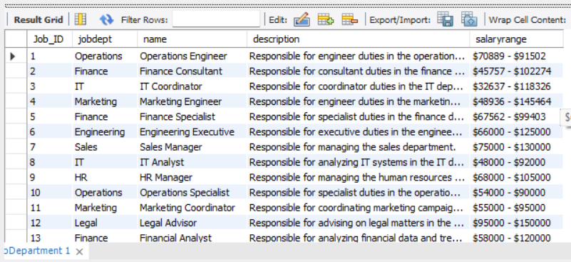
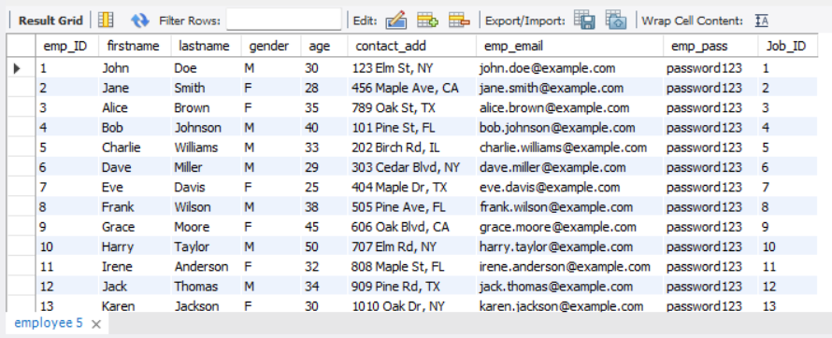
JobDepartment
Employee

Slide 8
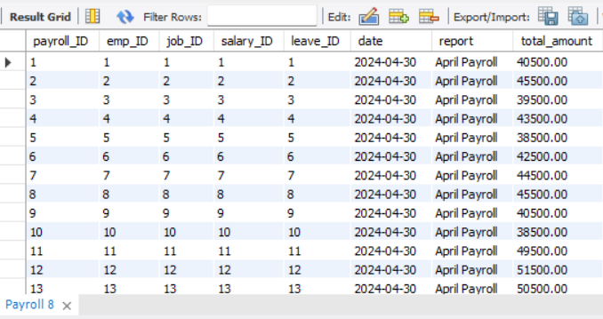
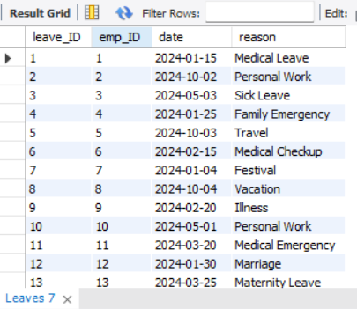
Payroll
Leaves

Slide 9
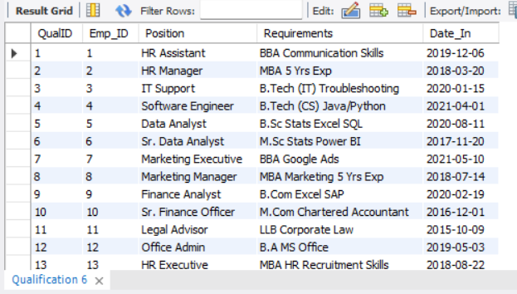
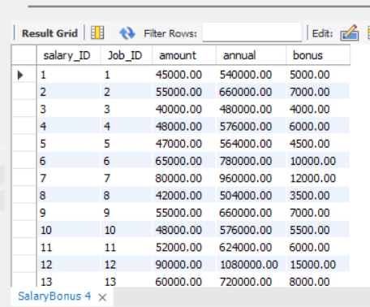
Qualification
Salary Bonus

Slide 10
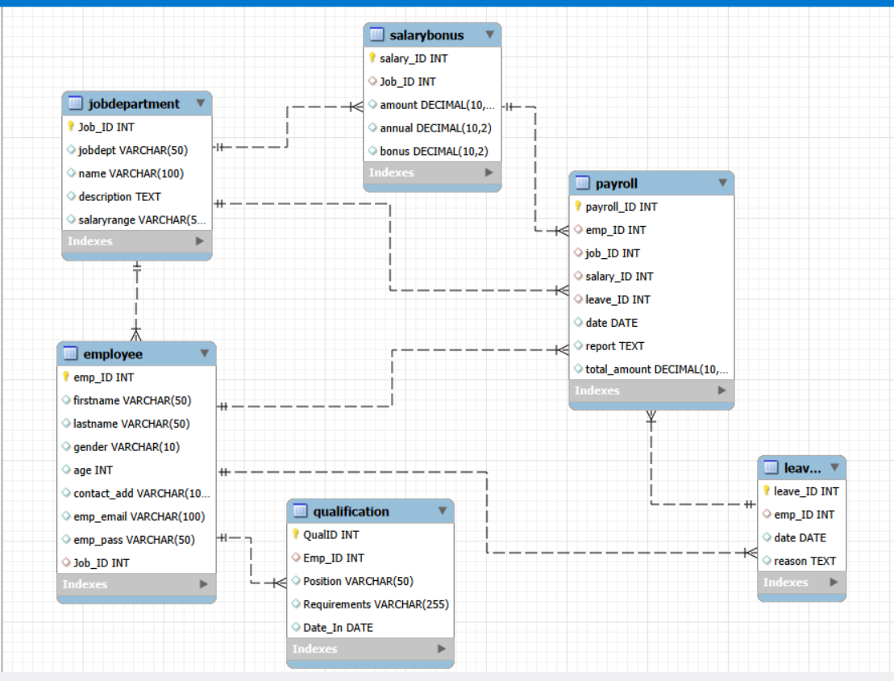
ER Diagram

Slide 11

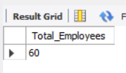
Analysis Questions
1. EMPLOYEE INSIGHTS
Q1.How many unique employees are currently in the system?

Slide 12
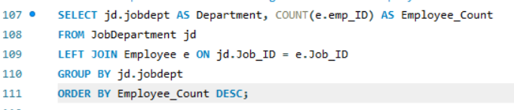
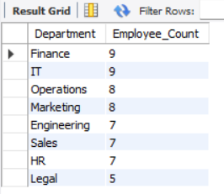
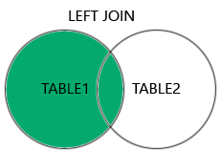
Q2.Which departments have the highest number of employees?

Slide 13
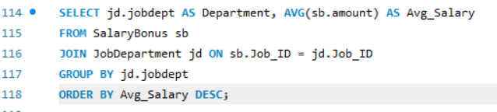
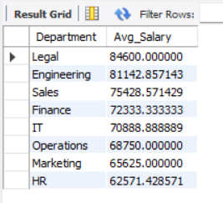
Q3.What is the average salary per department?

Slide 14
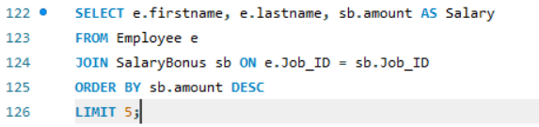
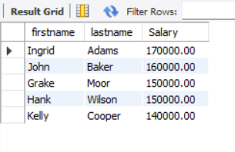

Q4.Who are the top 5 highest-paid employees?
Q5.What is the total salary expenditure across the company?

Slide 15

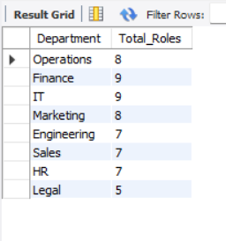
2. JOB ROLE AND DEPARTMENT ANALYSIS
How many different job roles exist in each department?

Slide 16
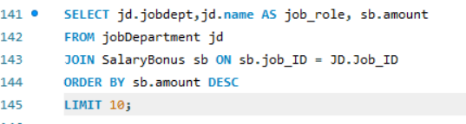
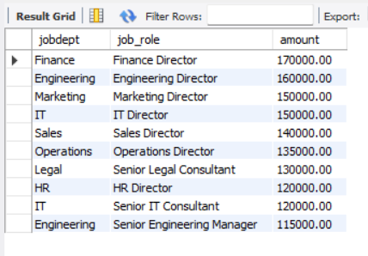
Which job roles offer the highest salary?

Slide 17
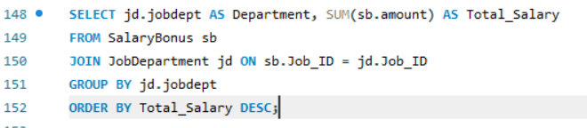
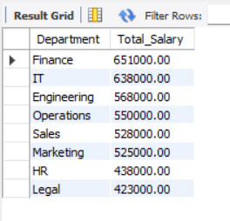
Which departments have the highest total salary allocation?

Slide 18


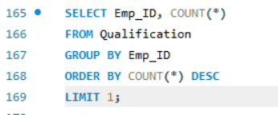
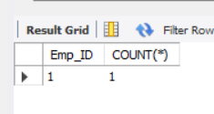
3. QUALIFICATION AND SKILLS ANALYSIS
How many employees have at least one qualification listed?
Which employees have the highest number of qualifications?

Slide 19
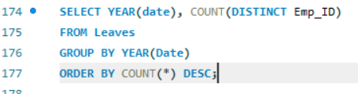
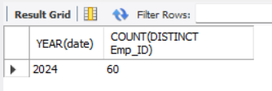
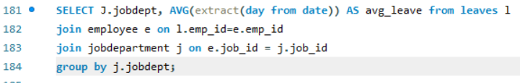
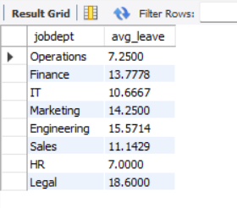
4. LEAVE AND ABSENCE PATTERNS
Which year had the most employees taking leaves?
What is the average number of leave days taken by its employees per department?

Slide 20
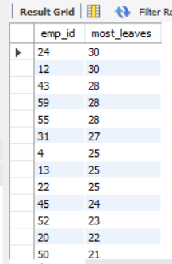
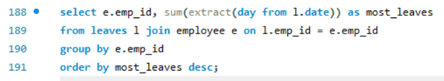
Which employees have taken the most leaves?

Slide 21
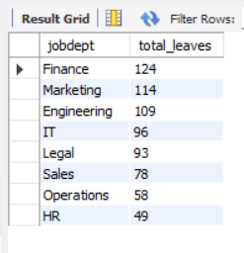
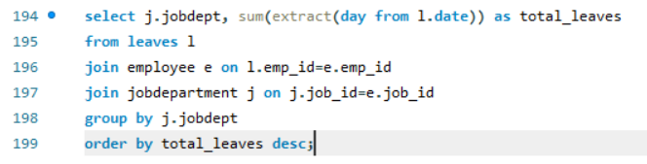
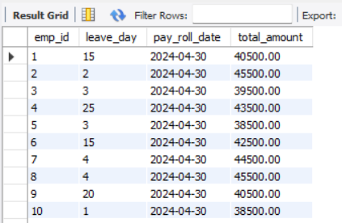
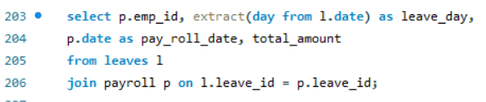
What is the total number of leave days taken company-wide?
How do leave days correlate with payroll amounts?

Slide 22

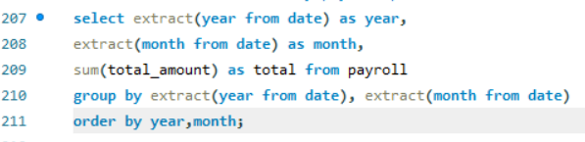
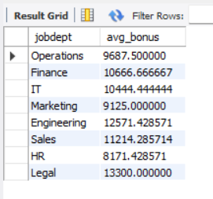

5. PAYROLL AND COMPENSATION ANALYSIS
What is the total monthly payroll processed?
What is the average bonus given per department?

Slide 23
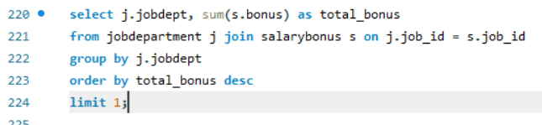
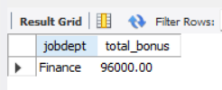

Which department receives the highest total bonuses?
What is the average value of total_amount after considering leave deductions?

Slide 24
Final Business Insights & Recommendations
Key Insights:-
Departments with more employees tend to have higher salary expenditure.
Certain job roles offer higher salaries and bonuses, influencing employee retention.
Leave patterns reveal workload stress or seasonal trends.
Payroll variations reflect bonuses, leave deductions, and job hierarchy.
Recommendations:-
Optimize resource allocation in departments with high salary expenditure.
Offer training programs for roles requiring high qualifications.
Implement better leave management practices to reduce productivity impact.
Automate payroll to minimize manual errors and speed up processing.

Slide 25
Challenges Working on SQL Project
Designing the ER diagram and establishing correct foreign key connections was challenging initially.
Writing multi-table JOIN queries required understanding relationships between tables.
Ensuring data consistency during inserts, updates, and deletes needed careful planning.
Handling date formats and generating time-based insights took additional effort.
Overall, the project improved my SQL understanding, query optimization skills, and analytical thinking.

Slide 26
Conclusion
The Employee Management System successfully demonstrate show SQL can organize and analyse large employee datasets. Through ER modelling, structured tables, and complex queries, the system provides valuable insights for HR decision-making, salary planning, and performance tracking. The project highlights the importance of relational databases in efficient workforce management.

Slide 27


Slide 28

THANK YOU

